Slide 1
Production of Lactic Acid Esters from Waste Derived Glucose
David Randall R&D Manager Chemoxy International Ltd

Slide 2

Scope of Presentation
Introduction to Chemoxy
Review of Waste2Go Project
Conclusions

Slide 3


2012- Present
Management buy out Renamed Chemoxy Int’l Ltd
2001- 2011
Dow Acquired Business
History >100 years operating
experience
1997- 2000
Ascot Holdings acquire Suter
Chemoxy renamed Haltermann
1984- 1994
Management buy out – Became Chemoxy Int’l
Suter Group Buys Chemoxy
Billingham site purchased
1965- 1975
North Western Oil Co purchased
1868
Company formed- All Saints Refinery Tar processing

Slide 4
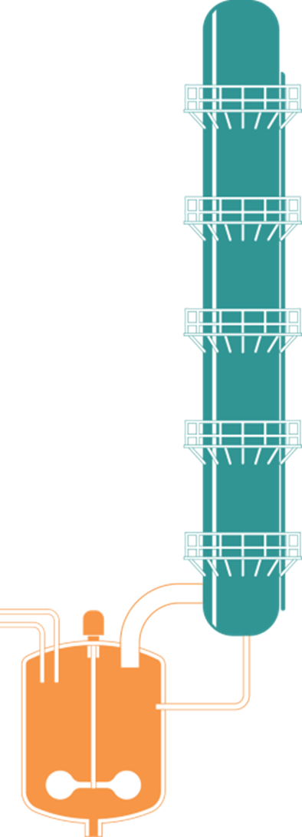
Capabilities
Reaction
8 Reaction Units 9-30m³
Glass, Stainless Steel
Chloride resistant steels
Solids handling/Filtration
Hazardous Chemistry
Distillation
7 High Resolution Fractionation Columns
Up to 50 Theoretical Plates
0.7 – 1.5m Diameter
High Vacuum
Side Streams
Temp to 240°C

Slide 5

Waste2Go Project – Chemoxy Participation
Initial Intention – Production of Industrially Useful Products from MSW Feedstock
Actual Activity
Fermentation of glucose derived from paper waste at CPI
Conversion of Lactic Acid to Butyl Lactate

Slide 6
Lactic Acid Ester Production
Stage 1
Conversion of waste paper to Glucose
Stage 2
Fermentation of Glucose to Lactate Salt (Fermentation)
Stage 3
Acidulation to liberate Lactic Acid
Stage 4
Stage 5
Extraction with n-butanol
Stage 6
Esterification to Butyl Lactate (acid catalysed)
Stage 7
Neutralisation of catalyst
Distillation of spec Butyl Lactate

Slide 7
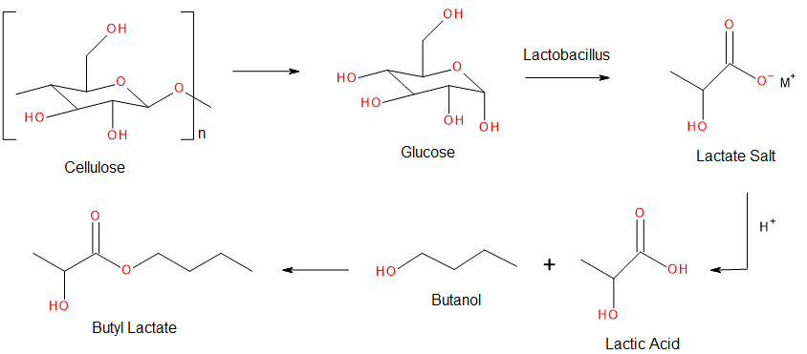
Lactic Acid Ester Production
Chemistry

Slide 8

CONCLUSIONS
POSITIVES
Collaboration with partners excellent
Industrially important product manufactured as demonstration
Commissioning of equipment at CPI a bonus
PROBLEMS
Final outcome somewhat disappointing
Project Management difficult
OVERALL – Rather like the Curate’s Egg! Good in Parts!

