Slide 1
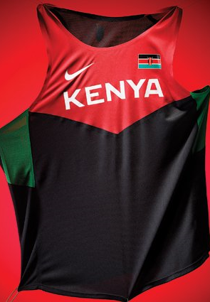
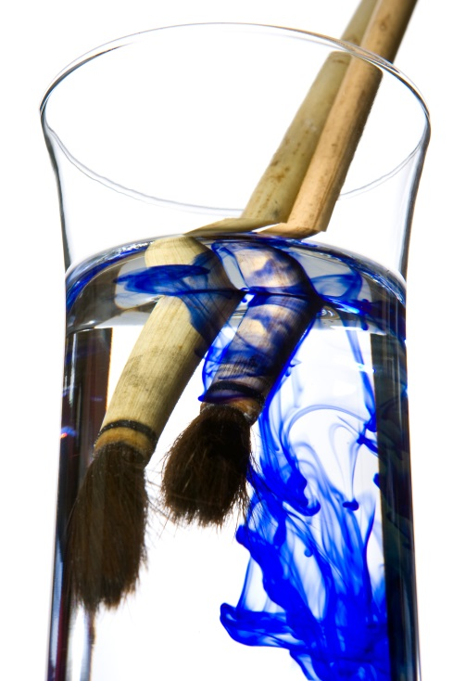
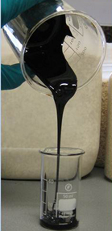
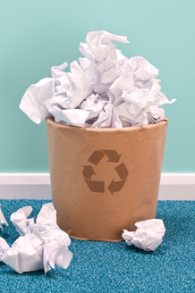

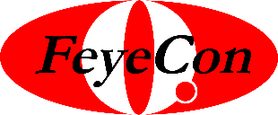
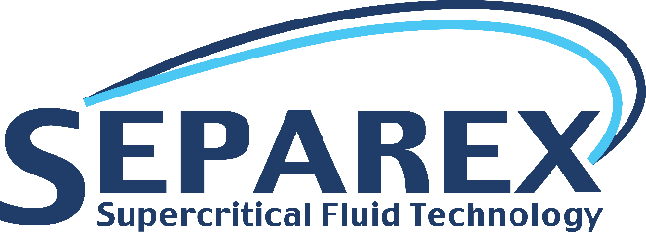
The FeyeCon Group
Innovative Solutions for waste recycling
Industry seminar
September 14th 2015
A. Ngomsik-Fanselow
J. Berriatua
R. Menendez
D&I.
Adding clean value
Engineering your future.
Part of the FeyeCon group

Slide 2
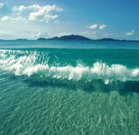
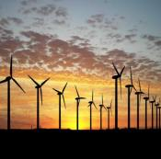
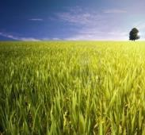
Our mission
We have a profound belief in a cleaner and more sustainable world
We use a CO₂ technology platform to innovate and improve processes and products.

Slide 3
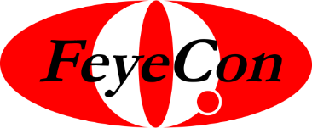
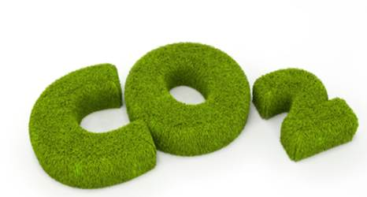
The
Group
FeyeCon is global leader in CO₂ Technology
Founded in 2001 by Geert Woerlee
150 employees – 18 nationalities - highly educated – 30% PhD
Over thirty five relevant patents
Market Intel: Textile, Polymers, Pharma, Food, Cosmetics, Material sciences
Twelve successful Joint Ventures
10 M€ revenues in 2014
International presence in Europe, the USA and Asia

Slide 4
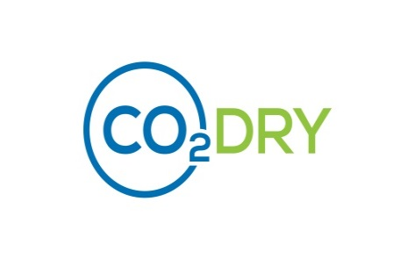
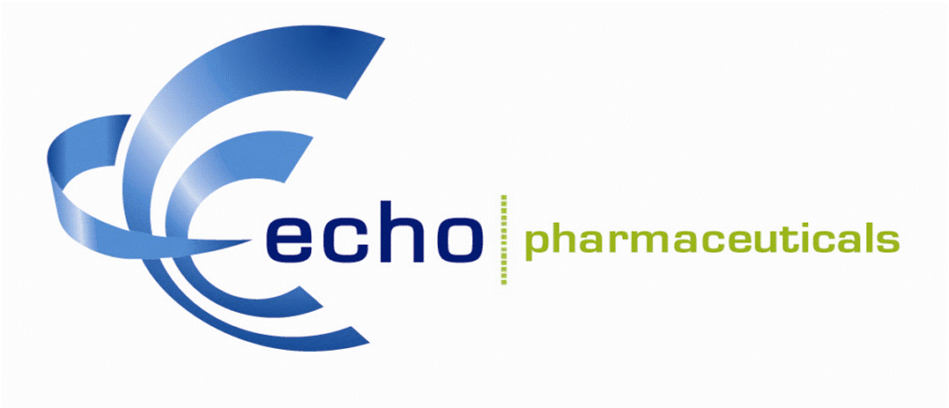


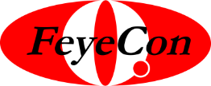
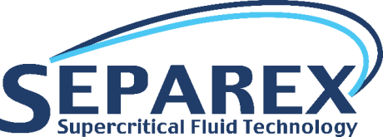

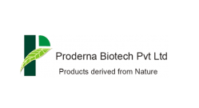
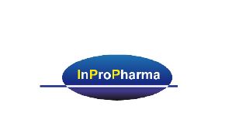
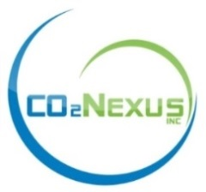
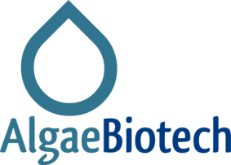
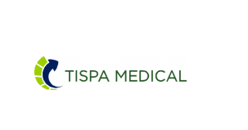
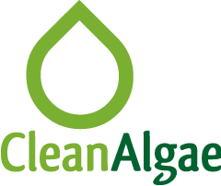
The
Group
Food
Pharma
Textile
Cosmetics
Champigneulles, France
Weesp, Pays-Bas
Développement & Implémentation
R&D
Process development
Equipment
R&D
Product development
Commercialisation
R & D
Process development
Pre-industrialisation
Market development
Engineering
Implementation
Production

Slide 5
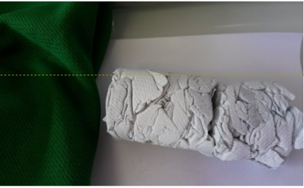
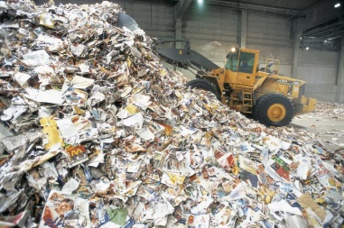
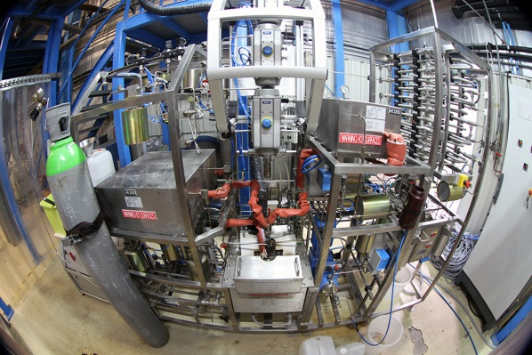
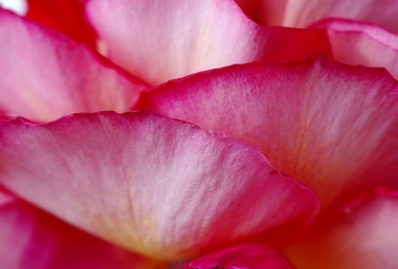
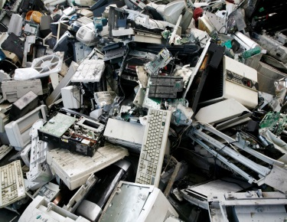
The know-how of the FeyeCon Group
R & D
Engineering
Business venture for various applications
Process Development
Separation Sciences
30 patents
Green tech
Scale up
Faster Processes
Decrease OPEX/CAPEX
30 years experience in the design/building of industrial equipment
Recycling of organic waste
Recycling of agriculture waste
Recycling of textile
Recovery of inorganic waste
Desalination of water

Slide 6
The FeyeCon Group
Recycling waste with Supercritical Fluids

Slide 7
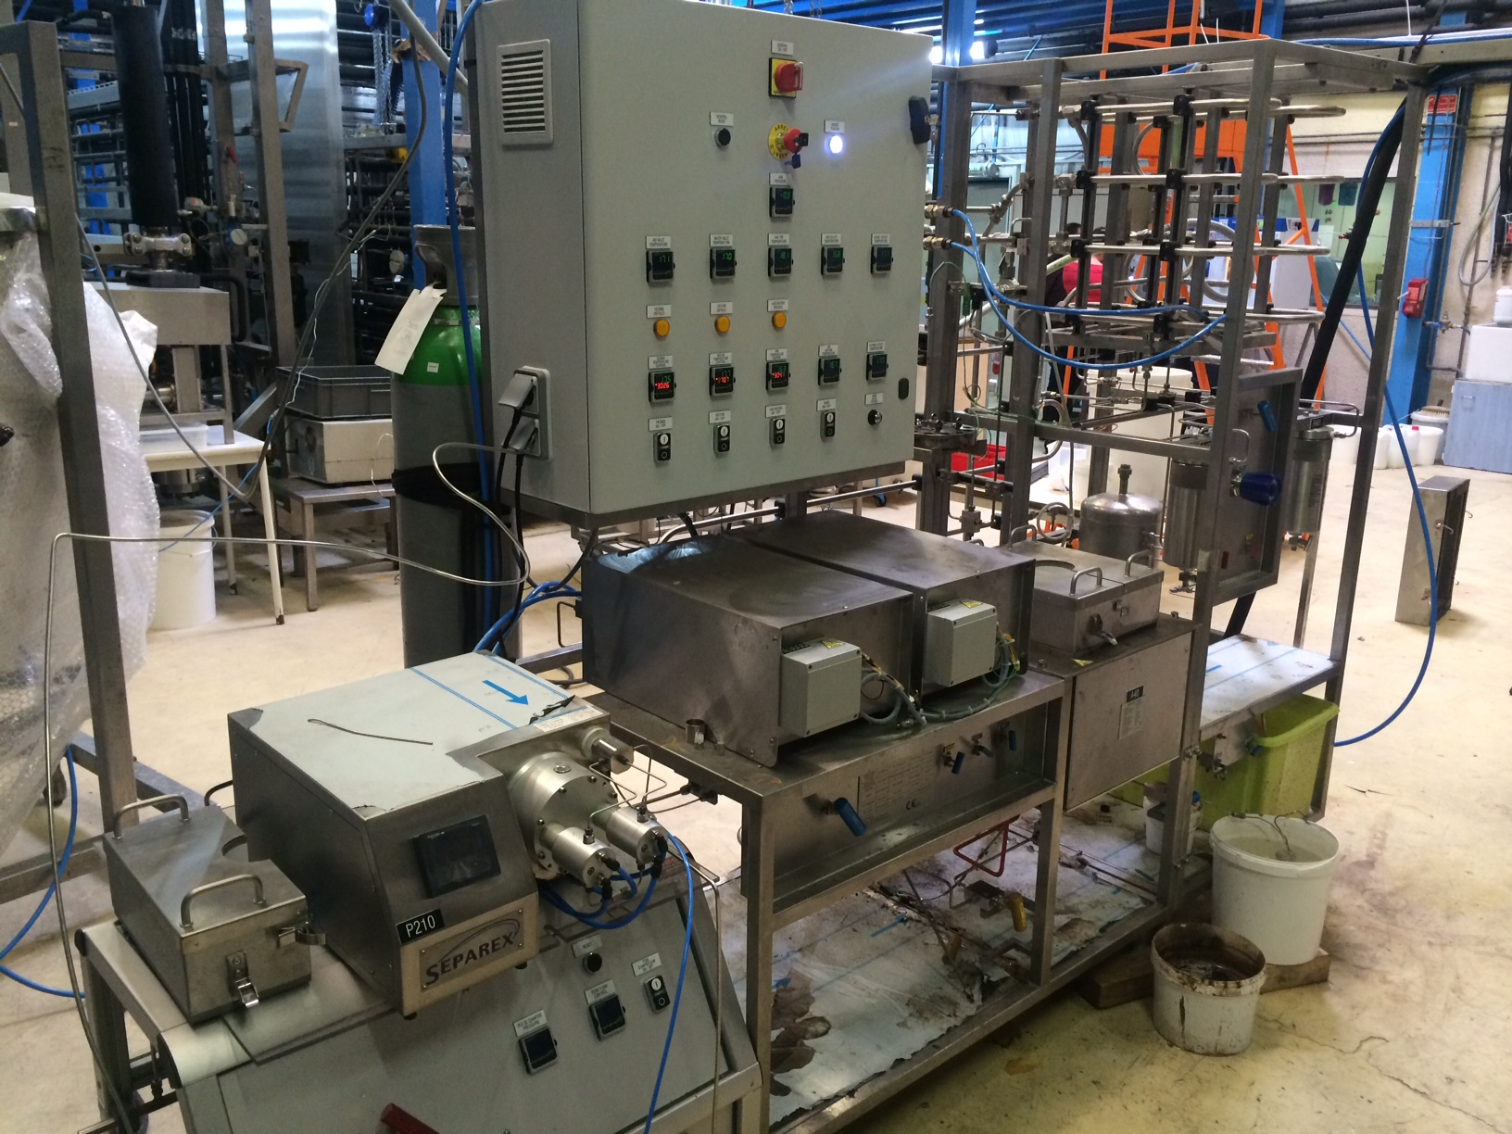
A- Supercritical water

Slide 8
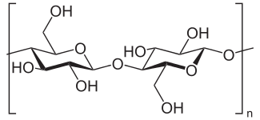
A- Supercritical water
1- Novel approach for the fractionation and purification of soluble and insoluble polymeric compounds

Slide 9


Super critical water | Reactions too fast to get added value compound Difficult to control Leads to degradation Energivore | If oxidation (SWO) : able to completely oxidise any organic compounds Reaction very fast Destruction of undesirable organic waste Recuperation of inorganic coumpounds (metals)
Sub critical water | Mass transfer limitations | Possible to get added value compounds

Slide 10
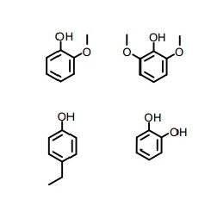
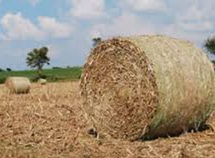
A- Supercritical water
2- Depolymerisation of lignin
Valuable phenolic coumpounds

Slide 11
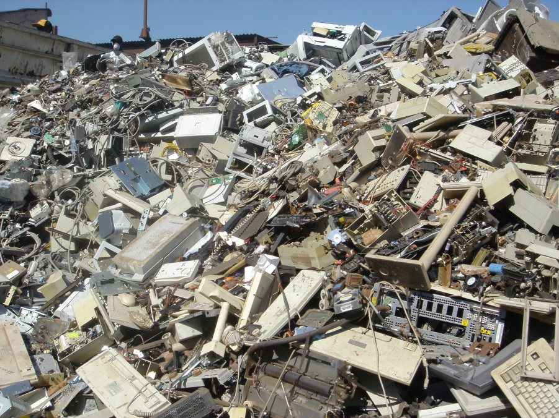
A- Supercritical water
3- Precious metals recovery from WEEE
Au, Co, Li...

Slide 12
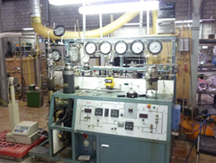
B- Supercritical CO₂

Slide 13
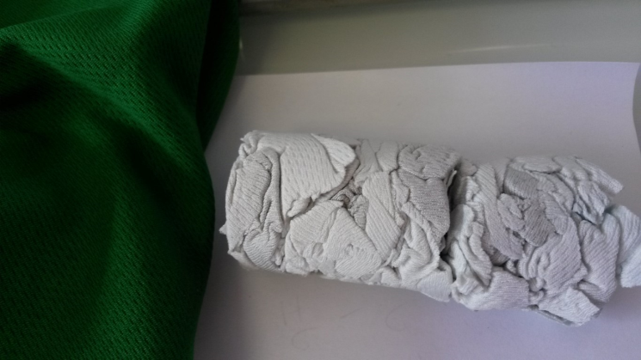
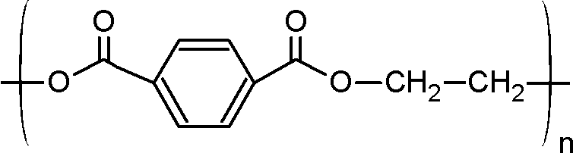
B- Supercritical CO₂
1- High value textile recycling: Decolouration of polyester
1 – To ease chemical recycling
2 - To allow redyeing
3 – To be used in plasturgy...

Slide 14
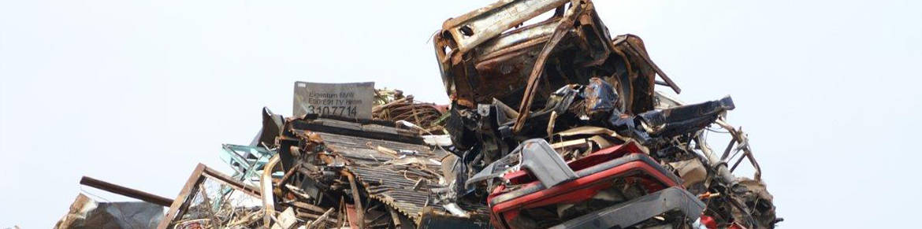
B- Supercritical CO₂
2- Recycling of Automotive Shredder Residues
Extraction of
Brominated Flame-Retardants

Slide 15

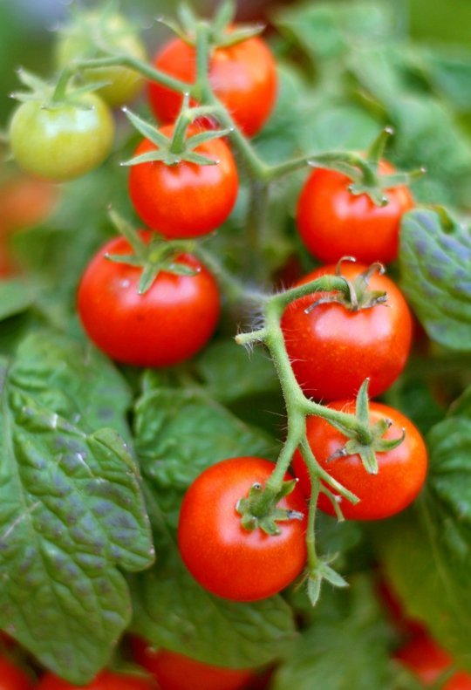
B- Supercritical CO₂
3 - Extraction of valuable components from agriculture waste
Pigments,
Anti-oxidants
Fragrance...

Slide 16
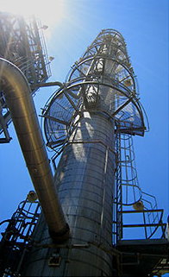
C- Supercritical CO₂
Fractionnation of fish oil
Separation of ω₃
from other fatty acids

Slide 17
Thank you for your attention !

