Slide 1

DEVELOPMENT AND VERIFICATION OF AN INNOVATIVE FULL LIFE SUSTAINABLE APPROACH TO THE VALORISATION OF MUNICIPAL SOLID WASTE INTO INDUSTRIAL FEEDSTOCKS
Work Package 5: Process development for cellulose degradation
Malcolm Lock (CPI)
Brussels14 - 15 September 2015
www.waste2go.eu

Slide 2
Introduction
WP5 Objectives
Process challenges
Developing mixing strategies: Biomixer MR2
The Biomixer in action
Solid-liquid separation technologies
Downstream processing using the Hydropress
Production of materials for WP6
WP5 Conclusions

Slide 3
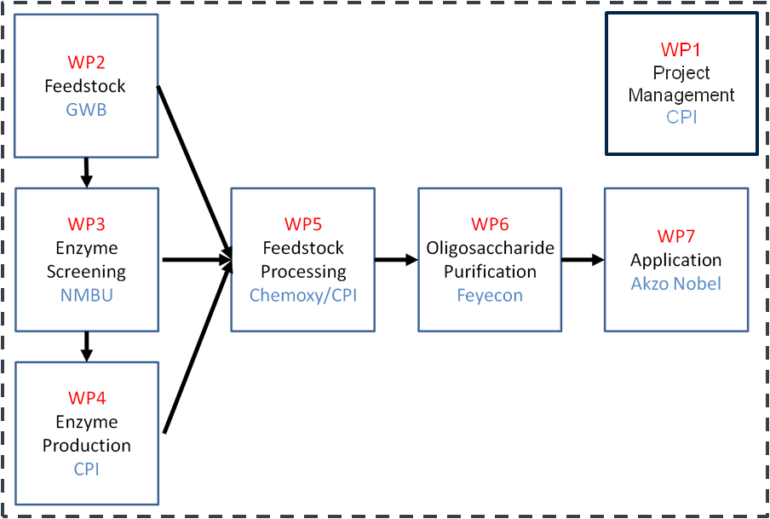
WP5 Objectives
Utilizing waste feedstocks from WP2 – data for feedstock development
Application of specific enzyme combinations from WP3
Process optimization for mixing cellulosic feedstock with enzymes
Solid-liquid DSP to provide feedstocks for WP6 process developments

Slide 4
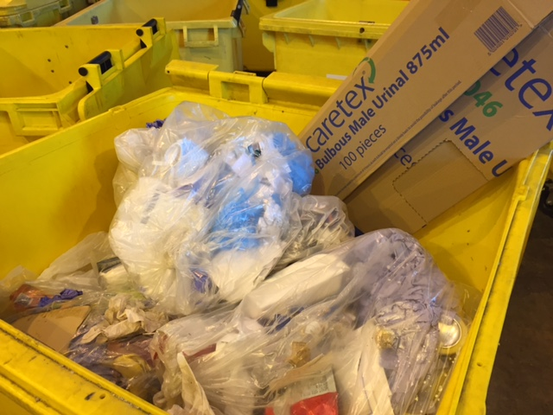
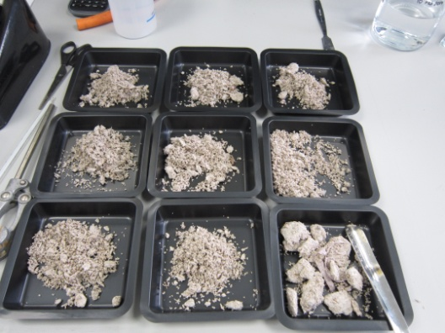
Process challenges for WP5
Require 15 – 20% (dw/w) loadings for acceptable yields
Dry weight
Cellulosic wastes have a high water content
Substrate composition
Cellulose low percentage of total weight
Cellulose content varies between waste streams and batches
Inhibitory components (e.g. metals from inks)
pH altering factors (CaCO₃ as paper whitener)
Accessibility of cellulose for degradation
Proportion trapped as crystalline cellulose
Pre treatment designed to increase accessibility
Batched at start or batch fed process (building up to target dw after liquefaction)?
Enzyme combination

Slide 5
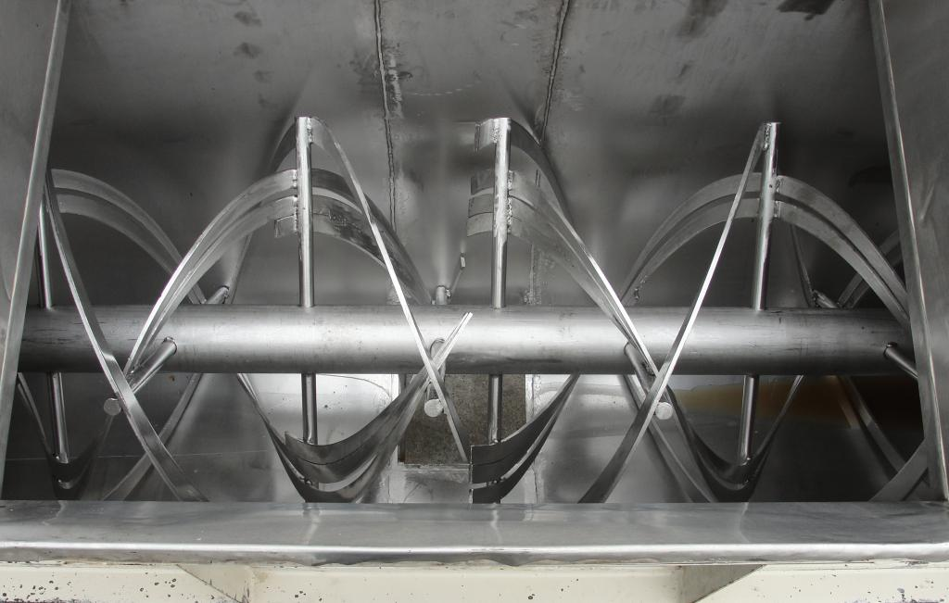
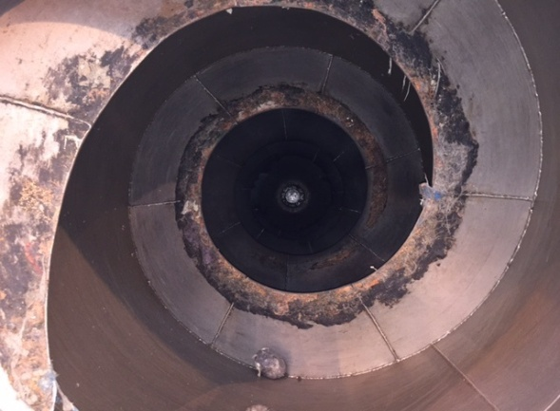
Process challenges: Mixing
Even at 6% dry weight solids loadings cellulosic suspensions have a high viscosity
Rusden impellors are not satisfactory for mixing dense / viscous materials
Impellor shape does not aid mixing
Compaction in column fermentor increases viscosity
Alternative mixing strategies needed to be employed:
Ribbon blender (bread and cheese manufacturing)
Rotary augar (waste processing)

Slide 6
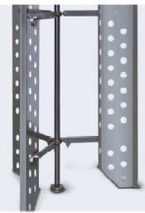
Process challenges: Designing a mixing vessel
Horizontal mixing more efficient
‘Lift and drop’ action maximises substrate coating with enzyme
Thermal jacket to control reaction temperature, data logging for multiple probe options
Consideration of loading and unloading operations

Slide 7
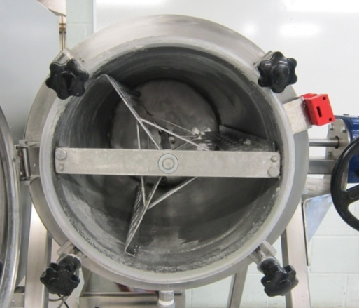
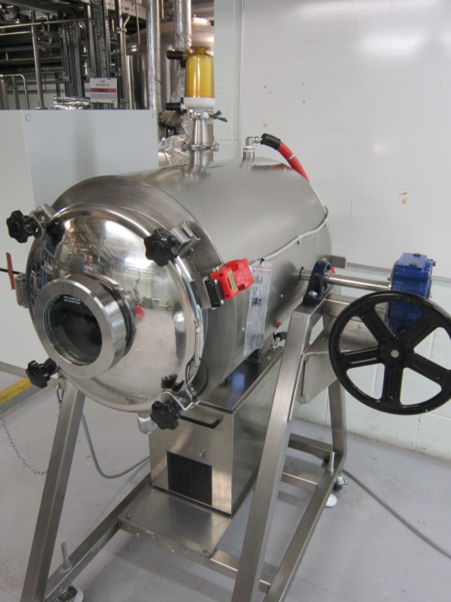
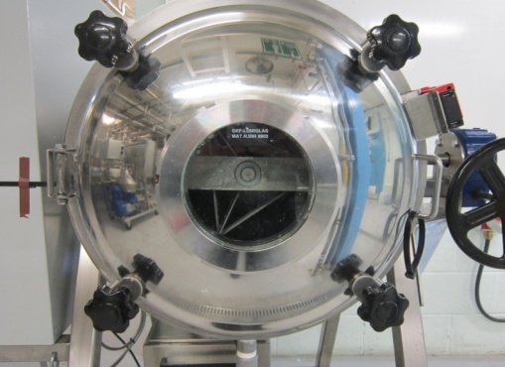
Biomixer MR2 Features – Mixing
Replaceable tri bladed impellor
Designed to “lift and drop” high viscosity materials, coating with enzyme solution
Drilled holes create vortex mixing once liquefaction has occurred

Slide 8
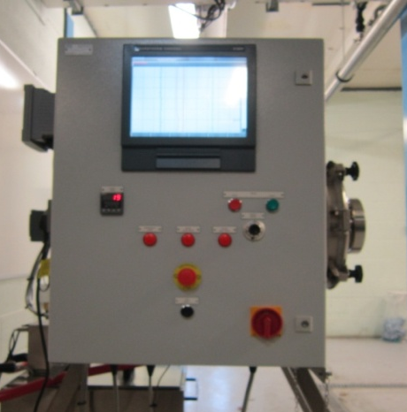
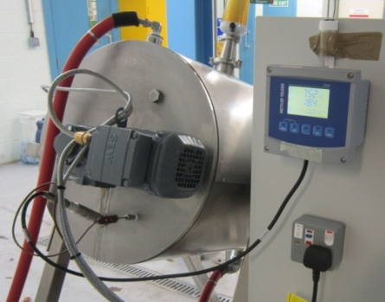
Biomixer MR2 – Data logging
Data collected through back plate mounted sensors: pH and temperature
Data logged through Eurotherm Chessel
Impellor driven by inline motor, 0.37kW, with 40:1 step down gearbox
Water jacket provides reaction temperature (Hüber recirculating water bath)

Slide 9
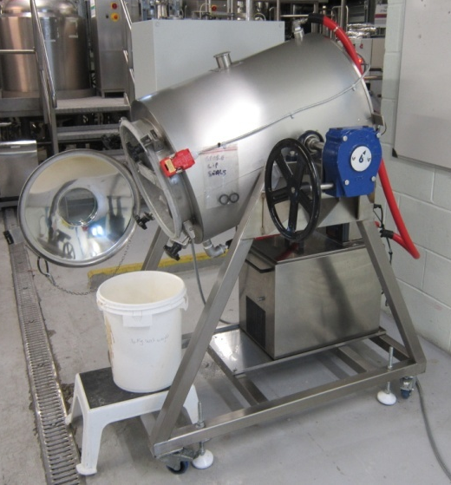
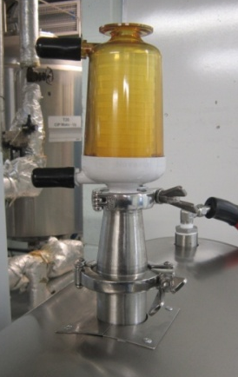
Biomixer MR2 – Loading and unloading
Top port modifiable (e.g. solids loading chute), currently acting as lute
Rotation for ease filling and unloading
50L working volume just fills vessel to below half
Sealed hatch to enable easy loading or unloading

Slide 10
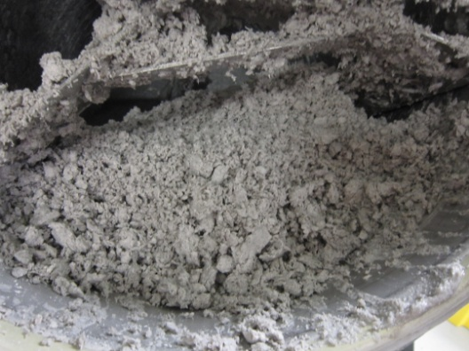
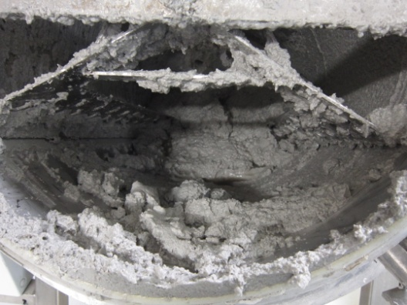
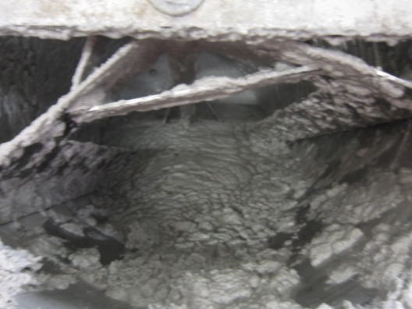
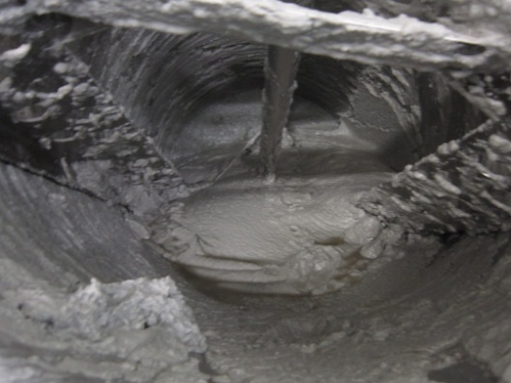
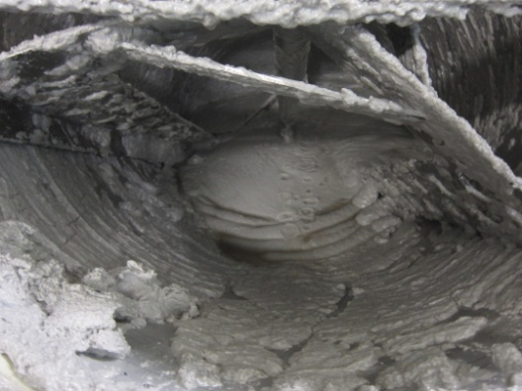
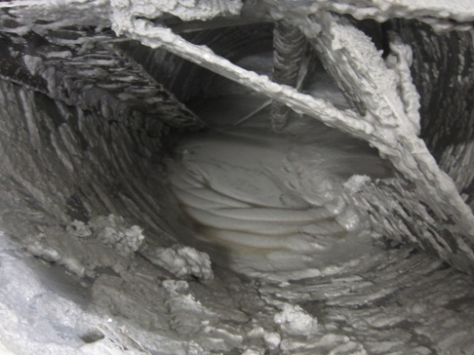
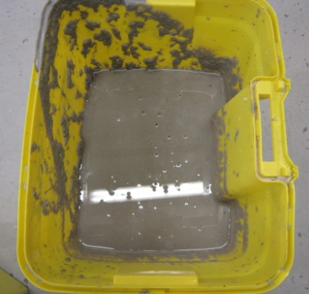
Biomixer MR2 in action
A. Starting material
B. 23 hours
C. 30 hours
D. 48 hours
E. 59 hours
F. 95 hours
G. 99 hours decanted material
Biomixer run 8 (20th to 23rd March 2015),
MaCel45a digest (11.75 g.kg (dw)⁻¹ in terms of total protein)
Acetic acid washed office white paper at 20.1% (w/v) dry weight
12.95 kg batched at start with 12.95 kg added after 4.5 h

Slide 11

Biomixer MR2 in action
Run 9: After batch addition solids
17.5 % dw/v loading
Balling and lift-drop action
Full slurry never formed
Run 3: Early trial with commercial enzyme
24.7% dw/v loading
Rapid development of thick slurry

Slide 12
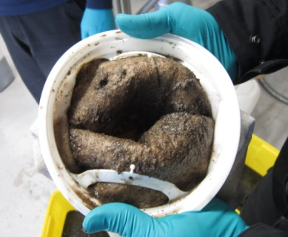
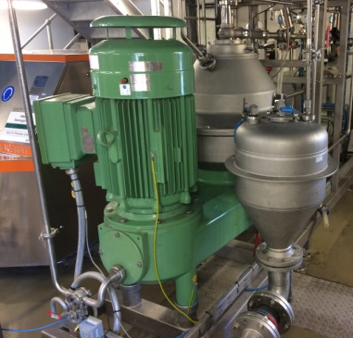
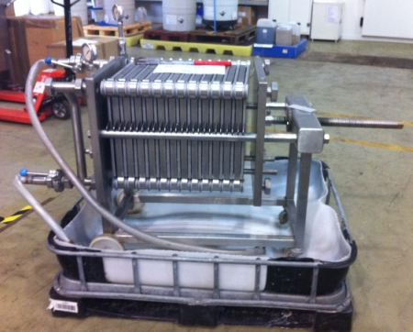
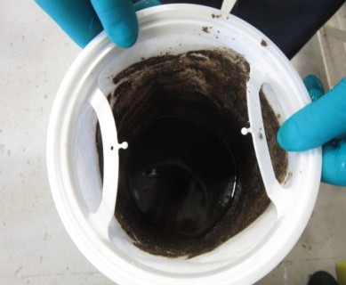
Solid-liquid separation technologies
Viscosity
Particle size of solids
Percentage solids content
Throughput requirements
Reaction of slurry to pressure
Target dry weight of produced solids
Centrifuge
Filter press
Gaffe bag
X
X
X

Slide 13
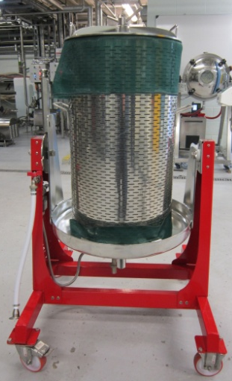
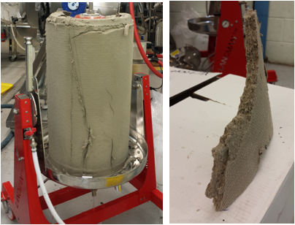
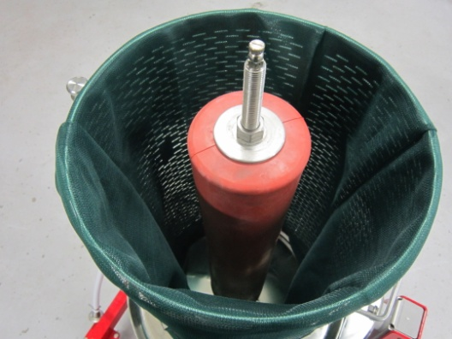
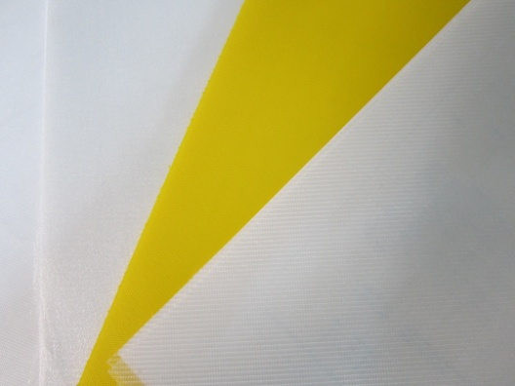
Downstream processing using the Hydropress
Lancman VSPX-98
98L capacity: 40L minimum working volume
Scalable technology (beer production)
Pressure range 0.1 – 2.9 bar
Process time dependent dewatering
Filter media available
Polypropylene monofilament lining bag (average 106 µm pore size)

Slide 14
Samples for fractionation trials
Direction from WP3: LPMO + MtCDH and MaCel45a yielded highest DP fragmentation
Dry Mixed Recycling and White Paper as substrates
Liquefaction observed in flask trials with both substrates and both LPMOs
Enzymes loaded with 1:1:1 ratio based on volume (concentrations comparable)
Batched at start with one solids addition after 24 h
Recoveries restricted by retention of sticky solids on Biomixer frame and CO₂ release
Hydropress produced solids with low water content

Slide 15
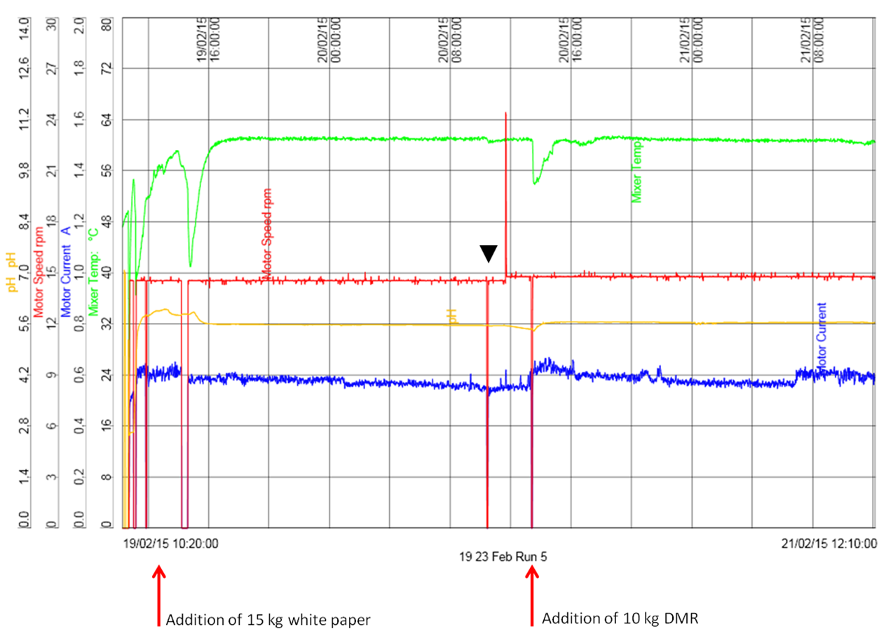
Samples for fractionation trials
Run 5 logged data showing stable pH and temperature control, motor current draw and stable rotation of the impellor

Slide 16
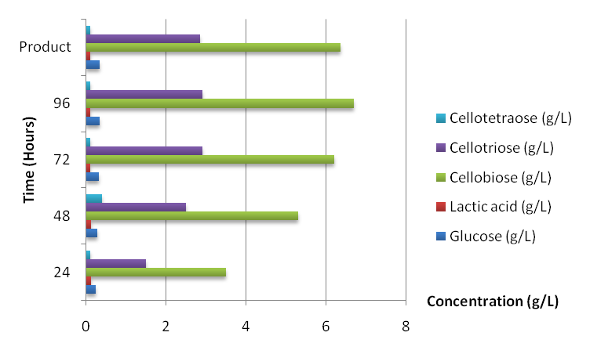
Samples for fractionation trials
Run 5 soluble sugar release with LPMO 3328
Run 6 soluble sugar release with LPMO 2916
Assuming entire added mass is cellulosic:
10.3% conversion to soluble sugars
3.62% yield soluble sugars
Assuming entire added mass is cellulosic:
26.1% conversion to soluble sugars
5.72% yield soluble sugars

Slide 17
WP5 Conclusions
Demonstration of high dry weight cellulose slurry mixing by Biomixer MR2
Sterility (no lactic acid production) can be maintained within Biomixer setup at elevated temp
DSP technologies for solid-liquid separation investigated
Hydropress sufficient for W2G separation requirements
Adequate mixing enabled production of soluble polysaccharides
Analytical capability at CPI cannot analyse insoluble polysaccharide breakdown
Scale up of process optimization factors exceedingly challenging
Range of soluble and insoluble polysaccharides from different enzyme digestions of varying waste cellulose feedstocks provided to WP6

