Slide 1

Industry seminar 14 September 2015
Scaled up production of enzymes from the yeast Pichia pastoris
Campbell Tang
Andrew Atterton
www.waste2go.eu

Slide 2
WP4 objectives and progess
Objectives
Develop fermentation and downstream recovery processes which enable adequate supply of cellulolytic enzymes of interest for use in degradation of waste to valuable chemicals
Scale up to 750L production process
Summary of progress
WP start: January 2013
WP end: December 2014
Total fermentations: 137
Six enzymes produced at 750L scale
Enzymes supplied to WP3 and WP5

Slide 3
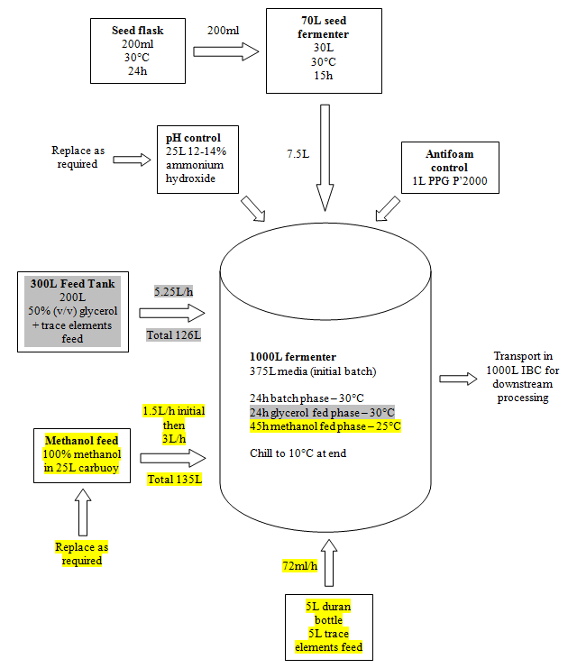
P.pastoris
AOX
process

Slide 4
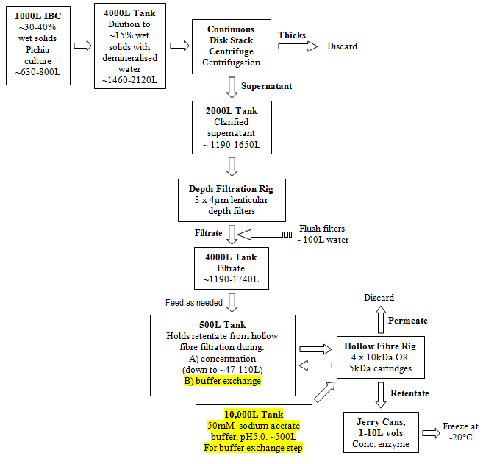
DSP
process

Slide 5
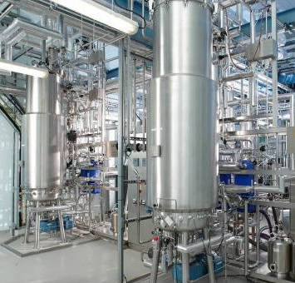
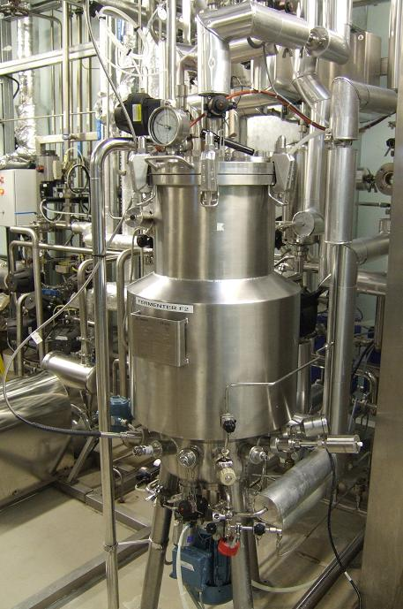
750L
fermentation
Seed bank cryovial
Shake flask
Notes:
750L process
5

Slide 6
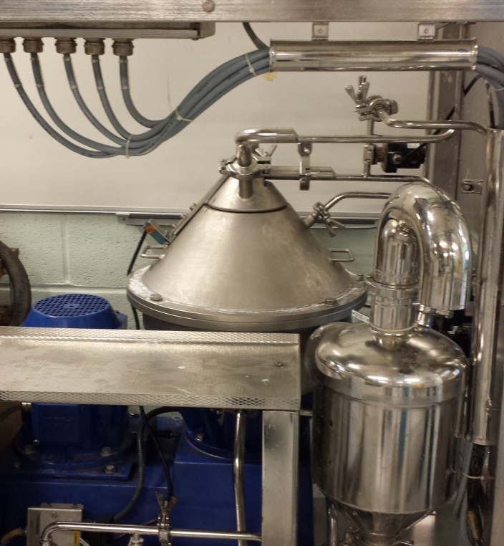
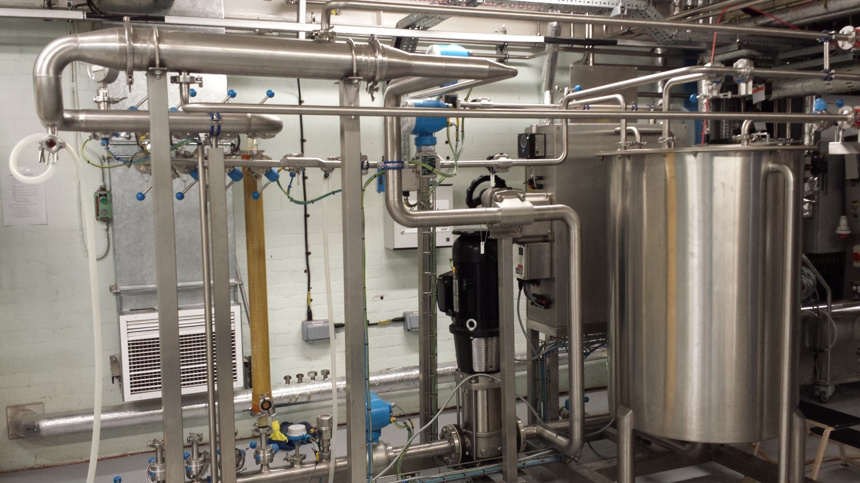
750L downstream processing
Continuous centrifuge
10 kDa Hollow fibre rig
Notes:
DSP 750L.
6

Slide 7
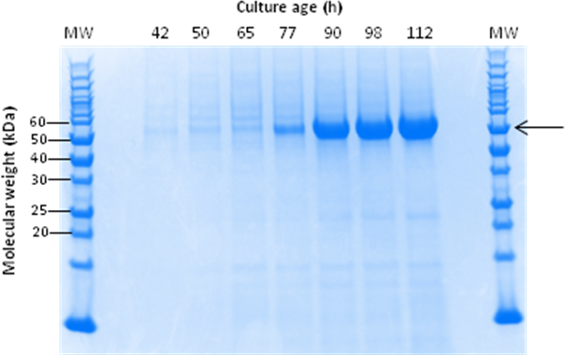
Production of LPMO 2916 enzyme
Seed fermenter bypassed
Batch extended 15h
Productivity exceeded 10Ls
No DSP issues
Notes:
58kDa
No cross-flow retentates or permeates taken BUT final product IS retentate. Permeate not shown but enzyme is over 11x bigger than pores

Slide 8
Some challenges
Enzyme production
Very high yeast cell densities up to ~140g/L DCW. Oxygen limitation. Foaming. Controlled feed rate, antifoam.
Seed fermenter contamination. Direct inoculation from flask.
Methanol – toxic and flammable. Incurs a 2-4h wait for adaptation. Prevent accumulation in fermenter, regular checks on level, maintain controlled feed rate.
Enzyme recovery and concentration
High cell density, solids content of 30-40%. Solved by dilution.
Cross flow filtration: change in scale-up, flat sheets to hollow fibre cylinders led to enzyme loss. Pore size changed.
Cross-flow filtration: higher growth at scale, more antifoam – blinds filter. Pre-filtration step introduced.
Notes:
In one ferm, the seed was low, feed had to be delayed and rate ramped up causing rapid growth and foaming

Slide 9
Future improvements
Activity assays – track productivity during fermentation, stability during recovery
Antifoams – possibility of removing depth filtration step
Centrifuge – need for dilution if can handle 30-40% solids
Use of hard-piped ATEX rated solvent vessel for methanol feeding
Enzyme concentration – introduce an extra filtration step to remove larger unwanted proteins
Strain – replace AOX with GAP, constant production, no methanol involved
Strain – faster production of enzyme to cut time and costs

Slide 10
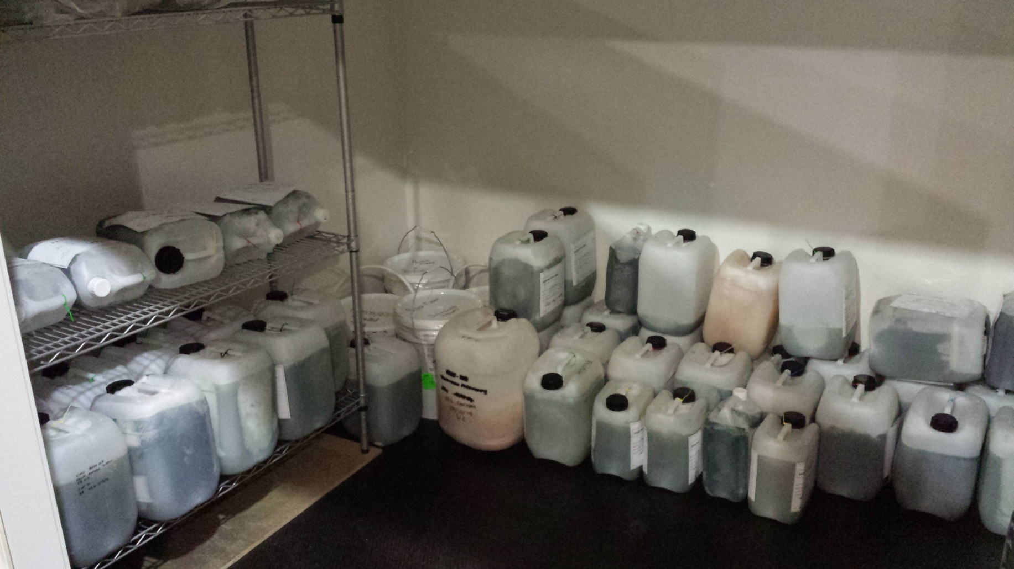
THANK YOU

