Slide 1
Waste Profile across the EC
The challenges associated with converting MSW into a resource
Jonathan Kearney (CPI)
Brussels14th September 2015

Slide 2
Introduction
Work package structure
  Literature review to establish current approach throughout the EC
  Investigation of the partial hydrolysis of different MSW streams through rotoclave.

Slide 3
Waste Profile – Undertaken by Fraunhofer IBP
Approach
Objectives of investigation:
1. Regulation of waste management systems (waste legislation)
2. Waste management systems (collection, treatment and disposal)
3. Prices for disposal of MSW
4. Composition and amount of MSW including biogenic content
5. Variation of the biogenic content of MSW between the different countries
6. Chemical and physical characteristics of MSW, respectively energy potential
and cellulose content of the biogenic substance

Slide 4
Approach for data collection
Methodological approach: literature research
Evaluated literature and data:
Published reports by the European Commission
Scientific papers
Statistical data from Eurostat
Relevant legal texts

Slide 5
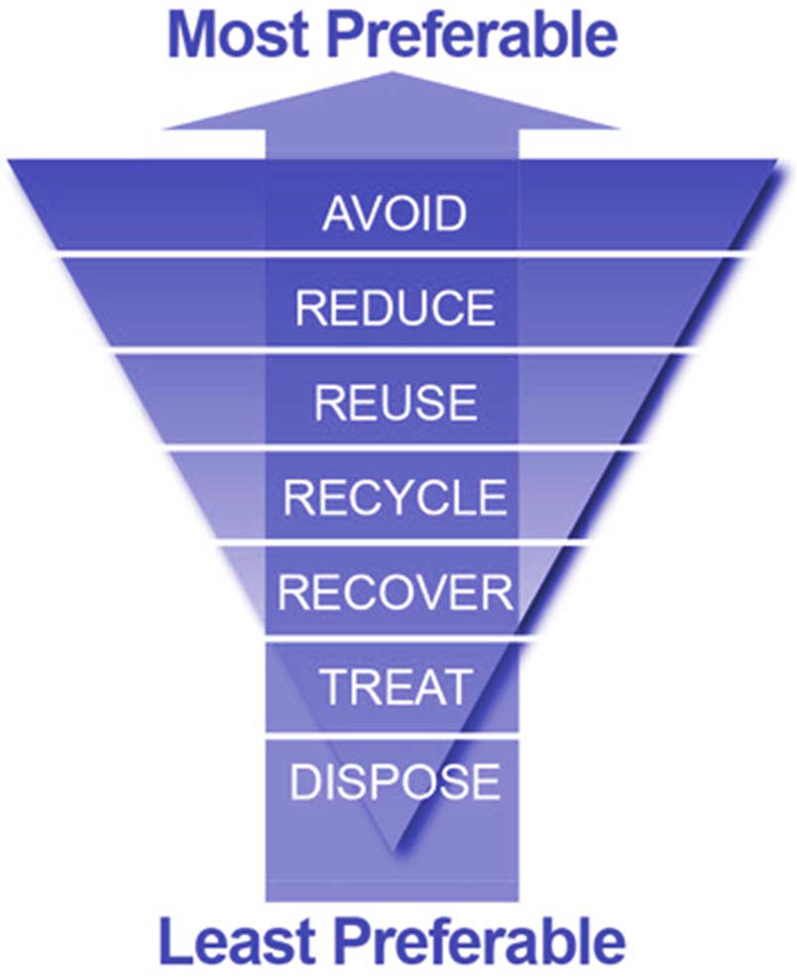
Waste legislation
Waste Framework Directive (Directive 2008/98/EC)
European Waste Hierarchy
Waste treatment operations:
Incineration (Directive 2000/76/EC)
Landfilling (Directive 1999/31/EC)
Waste shipments (Regulation (EC) No 1013/2006)
Waste statistics (Regulation (EC) No 2150/2002)
Waste streams (Directives on packaging waste,
batteries and accumulators, waste oils etc.)
www.zerowaste.sa.gov.au

Slide 6
Waste Management Systems
Collection - Kerbside systems - Deposit systems (recycling and drop-off centres)
Treatment - Sorting (if necessary) - Recycling - Incineration - Mechanical Biological treatment - Composting or digestion
Disposal - Landfill

Slide 7
Prices for disposal
High variance of disposal costs depending on:
Level of technology used
Existing restrictions or bans for final disposal into landfills
Aftercare and remediation of landfills
Flue gas treatment of incineration plants
Collection system respectively for sorting of co-mingled waste
fractions

Slide 8
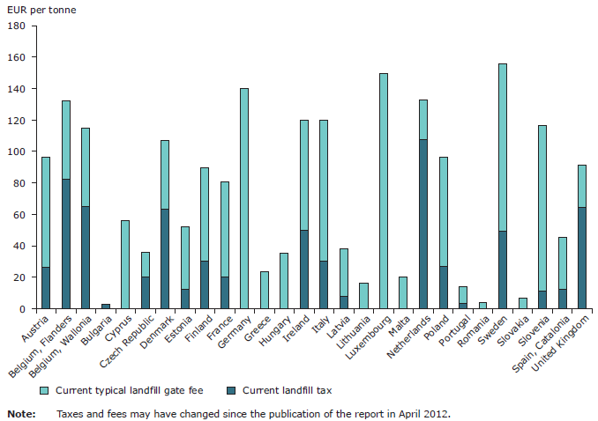
European Environment Agency (EEA): Managing municipal solid waste - a review of achievements in 32 European countries (EEA report, No 2/2013). Publications Office of the European Union, Luxembourg (2013).

Slide 9
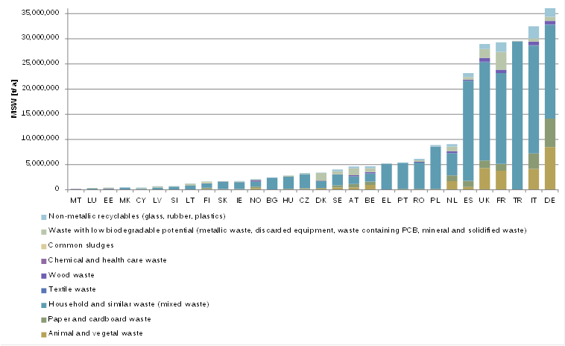
Scale of MSW generation
European Commission: Eurostat. Environmental data centre on waste, online available: http://epp.eurostat.ec.europa.eu/portal/page/portal/waste/key_waste_streams/municipal_waste, access date 24.01.2014.

Slide 10
Chemical and physical charicteristics
MSW varies in:
Calorific content
Moisture content
Cellulosic content
Inhibitors for microorganisms/enzymes

Slide 11
Waste Processing undertaken as part of Waste2Go
3 sources of MSW to be subject to at least 10 different thermo-mechanical processes to be examined by enzyme activity and compositional analysis
MSW thermo-mechanical treatment and post- processes are defined to optimise biogenic yield as a downstream feedstock for the production of chemical derivatives.

Slide 12
Challenges associated with processing
Waste collection market ‘fractured’
SME’s in the area operate in niche markets with tight margins so often willing but not able to support research
Facilities tend to be waste stream specific
Even ‘defined’ waste streams vary massively in composition

Slide 13
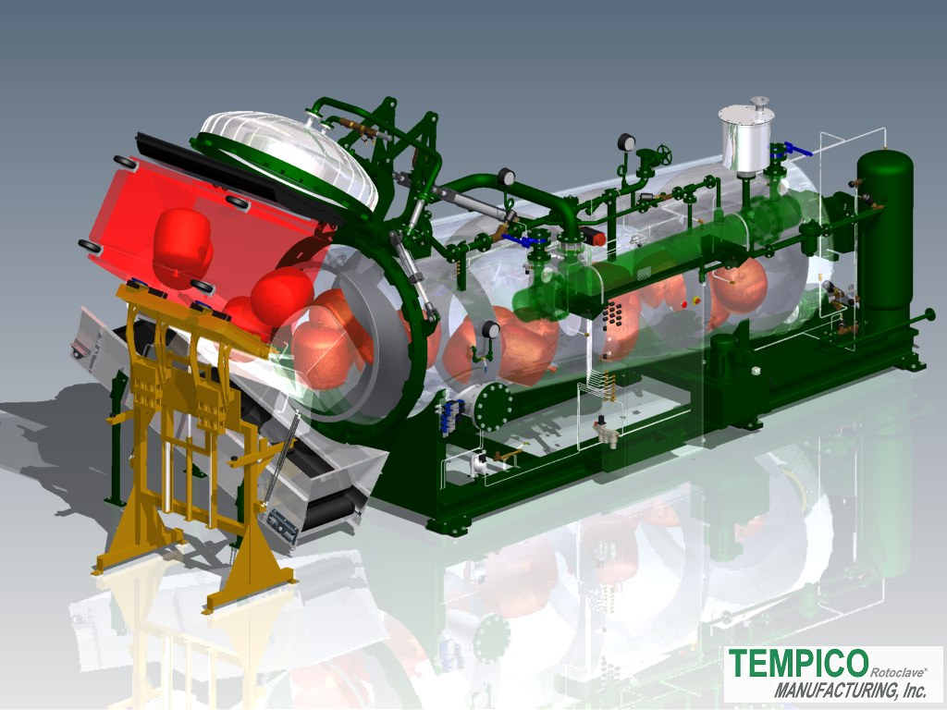
Equipment used

Slide 14
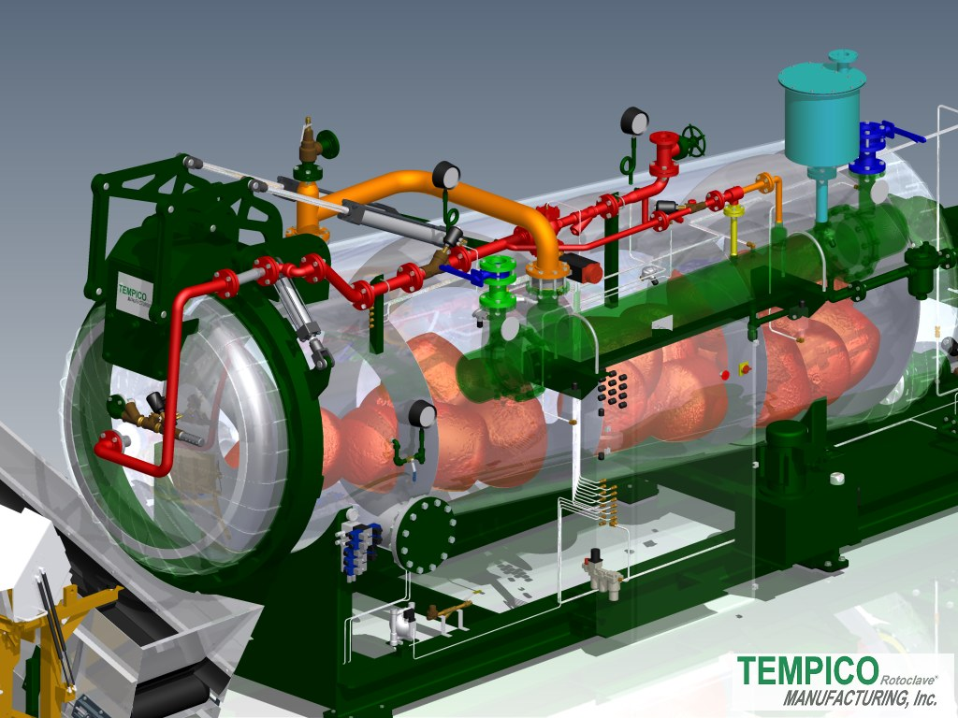

Slide 15
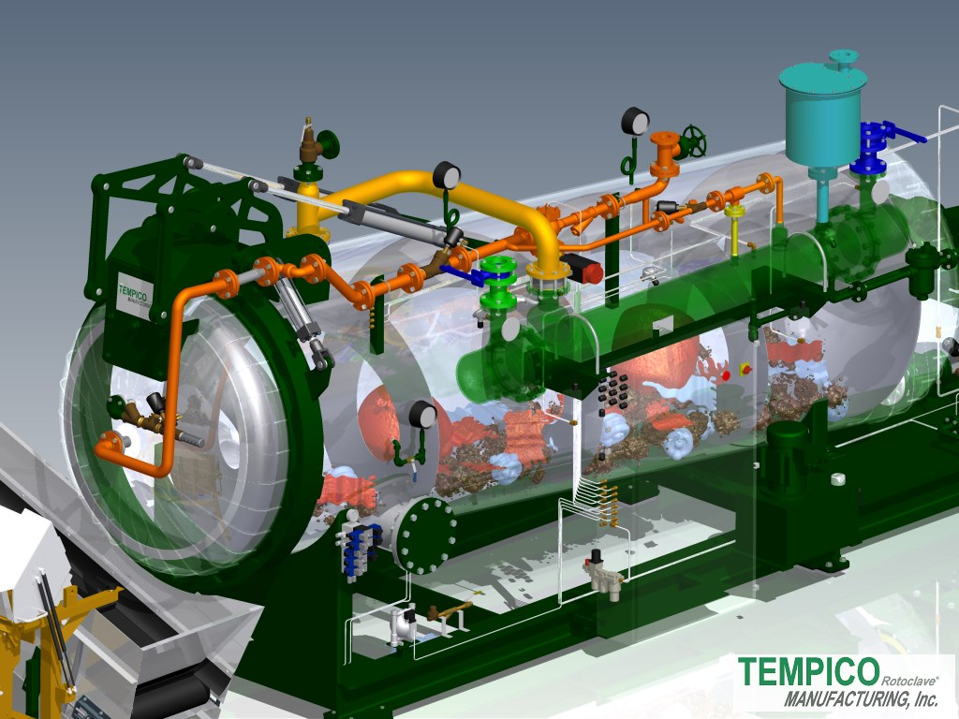

Slide 16
Paper trials

Slide 17
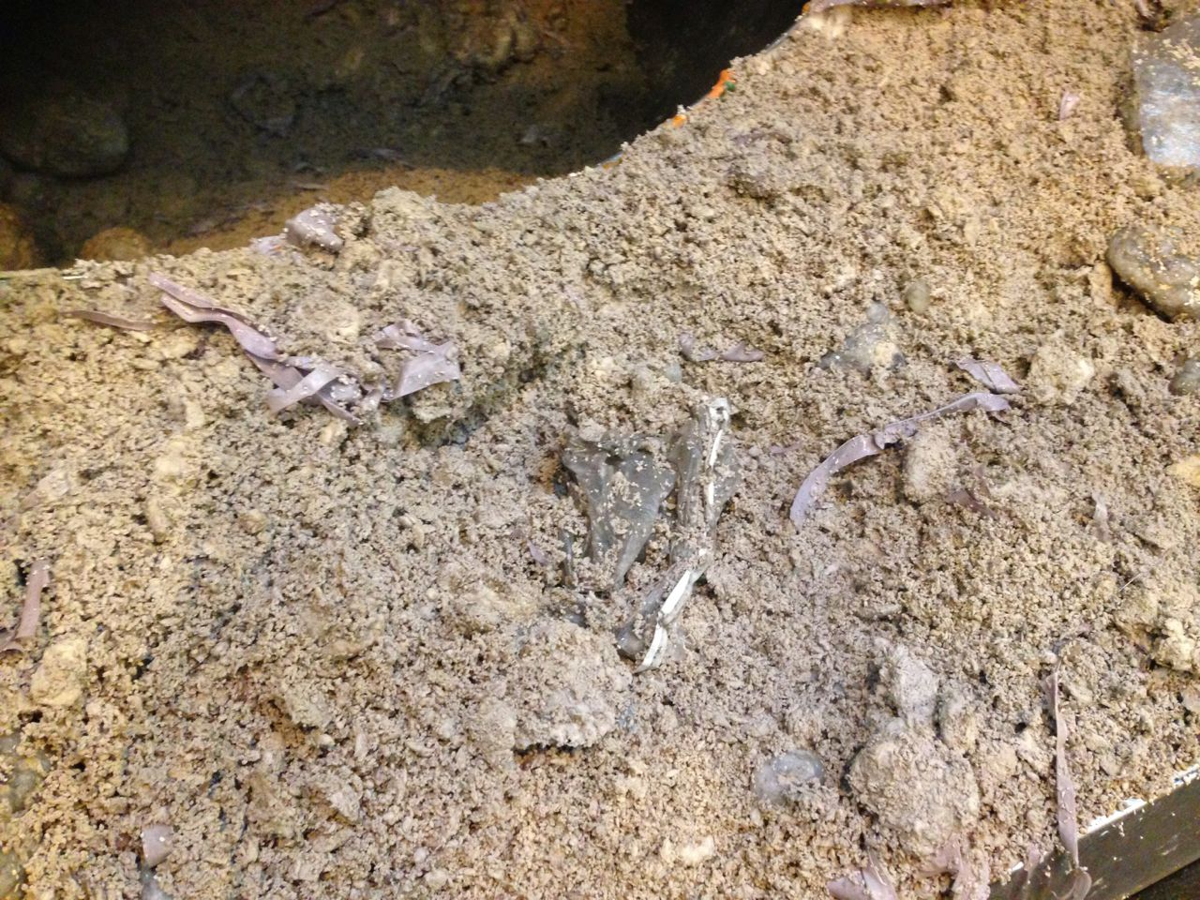
Final Material

Slide 18
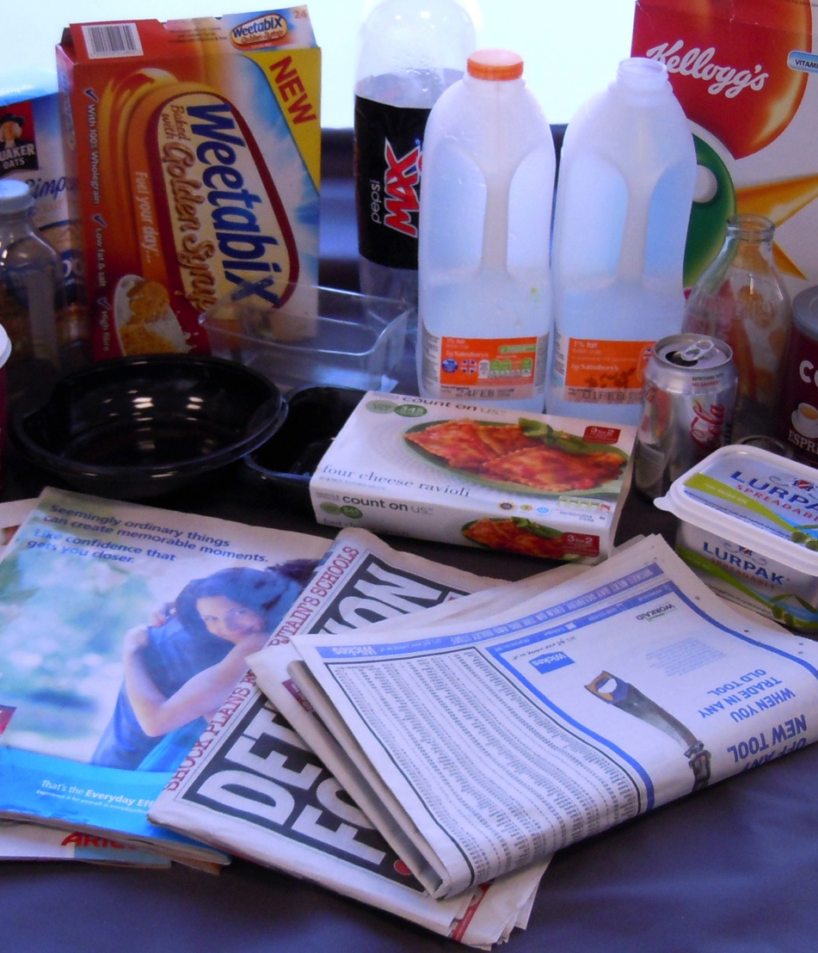
Dry Mixed Recycling (DMR) trials
Source material commonly found in the UK
Which contains a combination of source materials excluding food or liquids. Typical constituents are;
Newspaper
Magazines
Cardboard food packaging
Plastics (PET, HDPE)
Glass

Slide 19
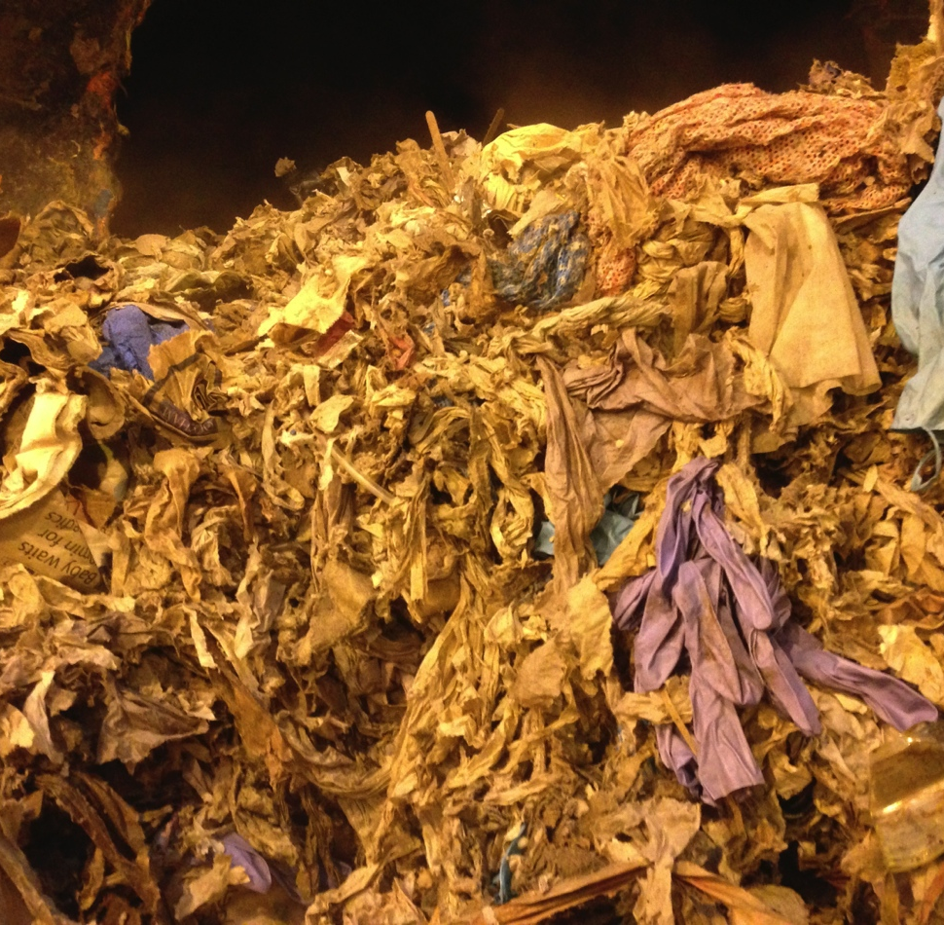
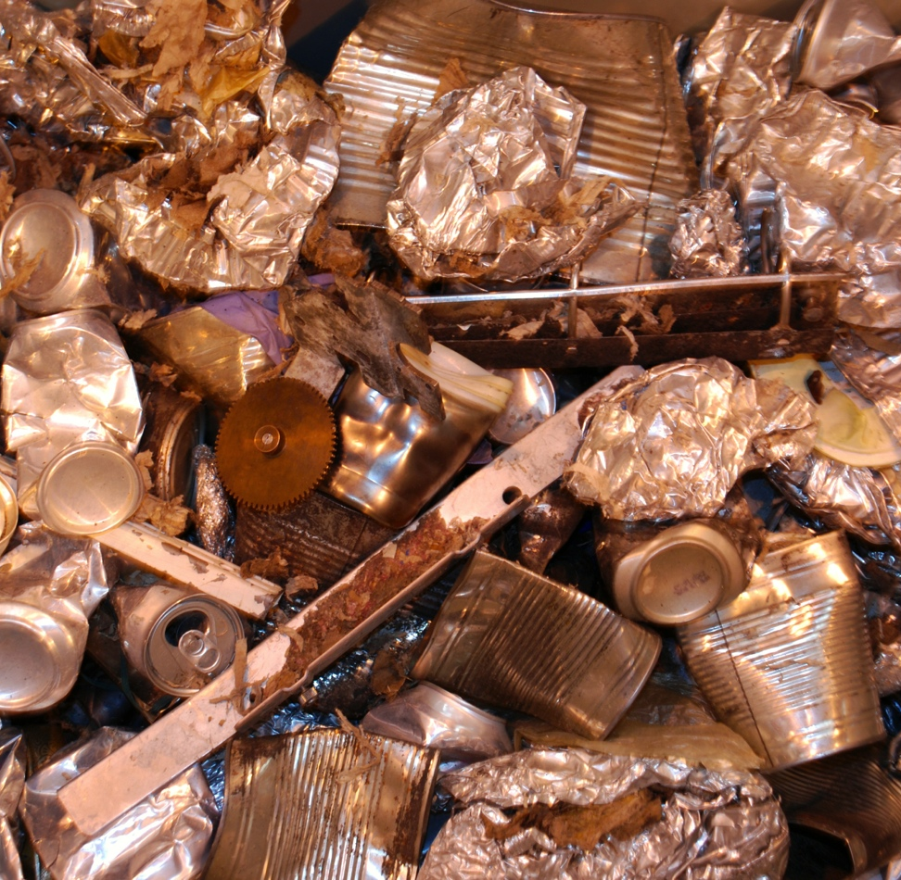
Early trials

Slide 20
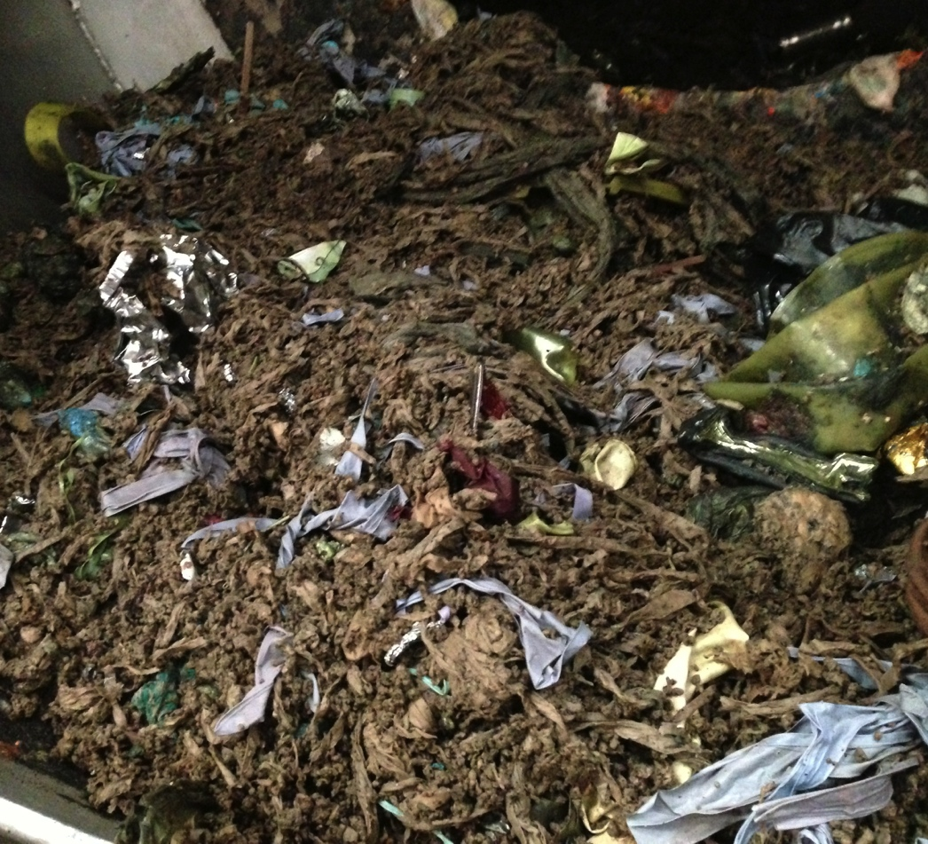
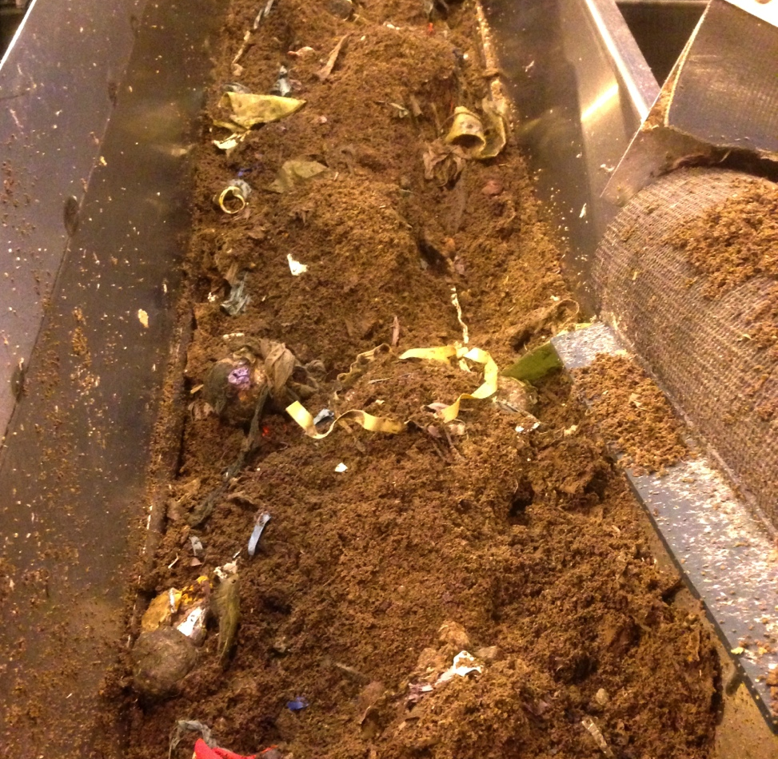
Observed results
Plastics, textiles metals and glass mixed with potentially usable substrate
DMR would require post process segregation using trommel screens, magnets eddy current separators

Slide 21
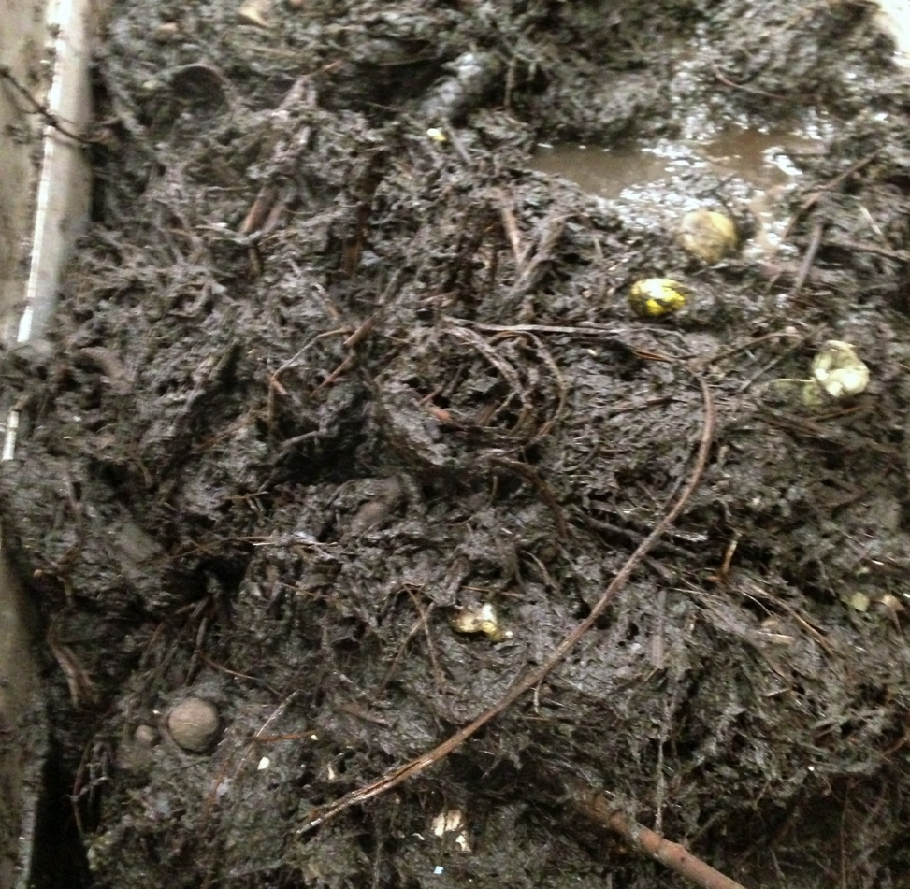
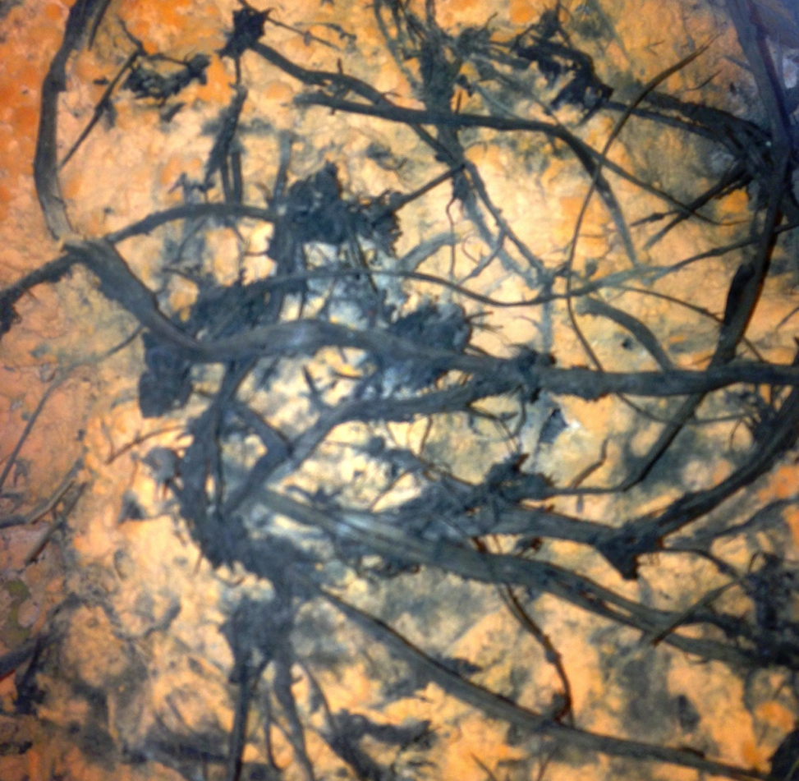
Organic rich waste sources -
Softer material broke down well but woodier branches remained in tact
After a few days, luminous orange fungus grew on the sample

Slide 22
Summary
MSW is an ill defined stream
Implementation of legislation varies between countries and hence waste handling likewise
It’s getting more difficult and expensive to dispose of waste
Rotaclave technology currently niche but viable in some commercial processes.
Partial hydrolysis of feedstocks is possible using this technique but challanging.

